Slide 1
Beta Arrestin Receptors Role in Conjunction with Mu Opioid Receptors (MOR)
By Maddi Bauer

Slide 2
Opioid- Oregon
1973 decriminalized marijuana
1st
Decriminalized other drugs
New penalties: $100 fine or attending an “addiction recovery centers”
1/11 Oregon residences are addicted to drugs
Help with racial discrimination?
Not the first country to try this
Portugal
Netherlands
Switzerland- chocolate!!!

Slide 3
Questions trying to Answer
How does beta-arrestin 2 impact antinociceptive tolerance in dependence- Morphine focused
Does Beta Arresting 1 and 2 differ in mediating MOR associated molecules
Define mechanism of MOR and beta arrestin interaction attributes of pain matrix

Slide 4
Main Characters
Mu- opioid receptors (MORs)
Beta Arrestin 1 and 2
Opioid
Notes:
Opioid focused on- Morphine

Slide 5
Supporting Character
GPCR- G protein- coupled receptors
Primary sensor neurons
Spinal dorsal horn neurons
Notes:
GPCR- utilized as a second messenger in the brain and are not fully understood with the mu opioid receptor and the anagesic affect it causes in the brain.

Slide 6
Pain
Congenital insensitivity to pain (CIP)/ congenital analgesia
Chronic pain
Is not always physical
Tickling
Nociceptors
Notes:
2 kind of pain: chronic and congenital insensitivity pain (CIP)/ congenital analgesia
CIP- individuals cannot feel pain
Chronic pain- caused by inflammation or dysfunctional nerve
Pain Matrix: anterior cingulate cortex, thalamus, and insula are what respond to pain stimuli- diagram on next slide.
Tickling is a form of pain, causes an autonomic emotional response.
Nociceptors do not exist in the brain which is why nero surgeons can perform surgery why the individual is awake and not pain management is needed to the extent that other surgeries may need.

Slide 7
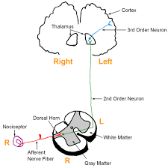
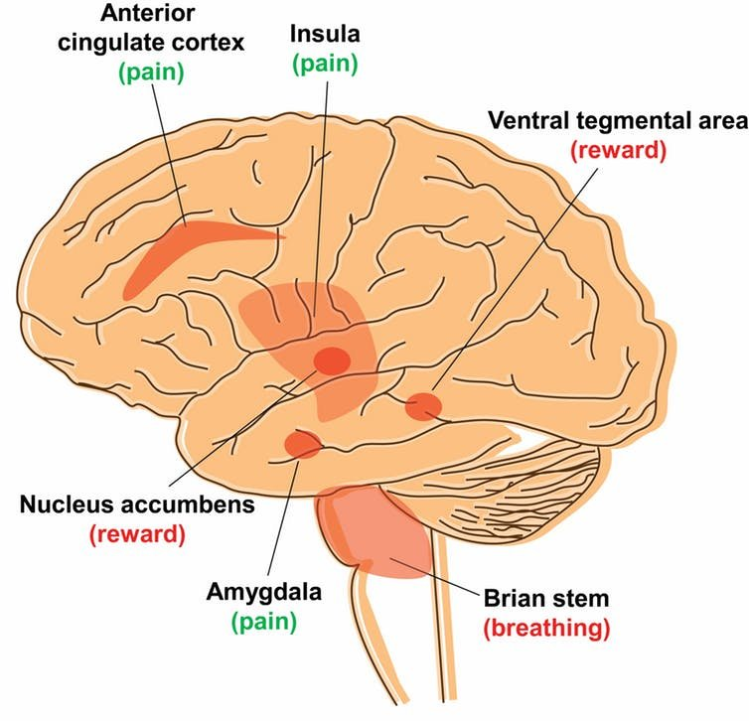
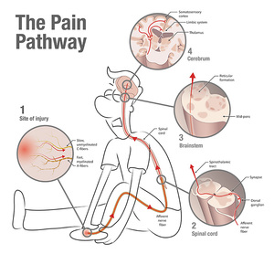
Nociceptors
receptors exists to feel all and any pain good or bad
Notes:
Nociceptors- found throughout the body except the brain
They are what ‘feels’ pain that could be mechanical, physical, or emotional pain
Examples of where these receptors can be found: skin, muscles, or bones.
Three kinds of nociceptors: thermal, chemical, mechanical
Nociceptive pain occurs in 5 phases
Transduction- occurs when peripheral terminals of the nociceptive c fibers and A-delta fibers are depolarized by Noxious mechanism, thermal, or chemical energy
Conduction- conduction across the peripheral process to the central process and is depolarizing the presynaptic terminal
Transmission- starts when the nociceptive action potential reaches the presynaptic terminals in the dorsal horn
Modulation- adaptive process involving both excitory and inhibitory mechanisms- this is where normal responding 2nd ordered neurons can be suppressed or activated.
Perception- dependent upon neural processing in the spinal cord and several brain regions. Assenting of the spinothalamic tract are decoded by the thalamus, sensorimotor cortex, insular cortex and the anterior cingulate to be perceived in the proper response.

Slide 8
Pain Matrix
Posterior Insula responds to diverse non-painful stimuli too
responds to both pain and non painful responses
Associated with nociceptors responses
No clear definition

Slide 9
Primary Sensory Neurons
Afferent neurons
Located in the spine and dorsal ganglion
spinal dorsal ganglion- body stored in the
Also stimulated via trigeminal or cranial nerves
Sense: temperature and touch stimuli

Slide 10
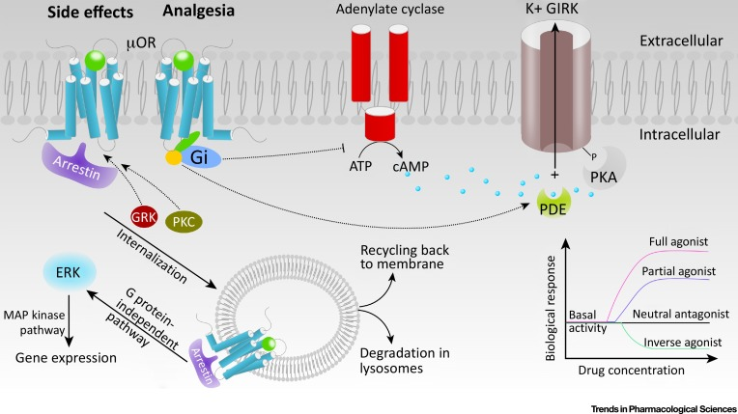
Opioid- addiction mu receptor
Notes:
Also called opioid use disorder
Stems from the mesolimbic pathways- regulates motivation and gives us pleasure- motivating us to repeat them
This is where addictions occur
GABAergic interneurons regulate the dopamine that can be inhibited by the mu opioid receptors
This drives early beginning of addiction
cAMP makes neurons more likely to be polarlized- with more camp having a stronger reaction- mu opioid inhibit cAMP and shuts off neurons
This decreases over time in longer term opioid use
Thus, individuals need more opioids to overcome the body overriding current doses
We will discus the G-protein receptors with looking at the beta arrestin receptors
GRK a signaling molecule- important for discussion

Slide 11
Hypothesis, problem, Why this is important
Hypothesis
Problem
Importance
Notes:
Hypothesis: Through our understanding of the beta-arresting and MOR interactions IT may provide a novel mechanism by which to produce analgesia with less sever adverse effects through alternative beta arrestin contribution or other contributions to MORs in conjunction with a dose dependent response with morphine.
Problem: It is unclear whether opioid-induced analgesic tolerance are solely due to stimulation of MORs expressed in DRG neurons in conjunction with unknown interactions in the primary sensory neurons produced by systemic opioids using in animal model in which MORs are entirely eliminated from the DRG. Basically, we do not know enough about the b-arrestin ½ interactions with MOR of longer term use as a pain management technique.
The importance of these papers contribute to the understanding of b-arrestin role in addictive responses in the mu opioid receptors. With understanding of the MOR and b-arrestin interaction it can help develop ways of mitigating treatment for individuals addicted to opioids and opioid like drugs. Through this mitigation longer term remission can be achieved through the understanding of the interaction of b-arrestin, mu opioid receptors. This will help save lives and change individuals live who are affected by these drugs.

Slide 12
Methods of Investigation
cDNA constuction
B-arrestin translocation
MOR Internalization
B- Arrestin Rescue of MOR Internalization
MOR Ubiquitination
MOR Dephosphorylation
Intrathecal injection- lumbar puncture technique
Tolerance Paradigms

Slide 13
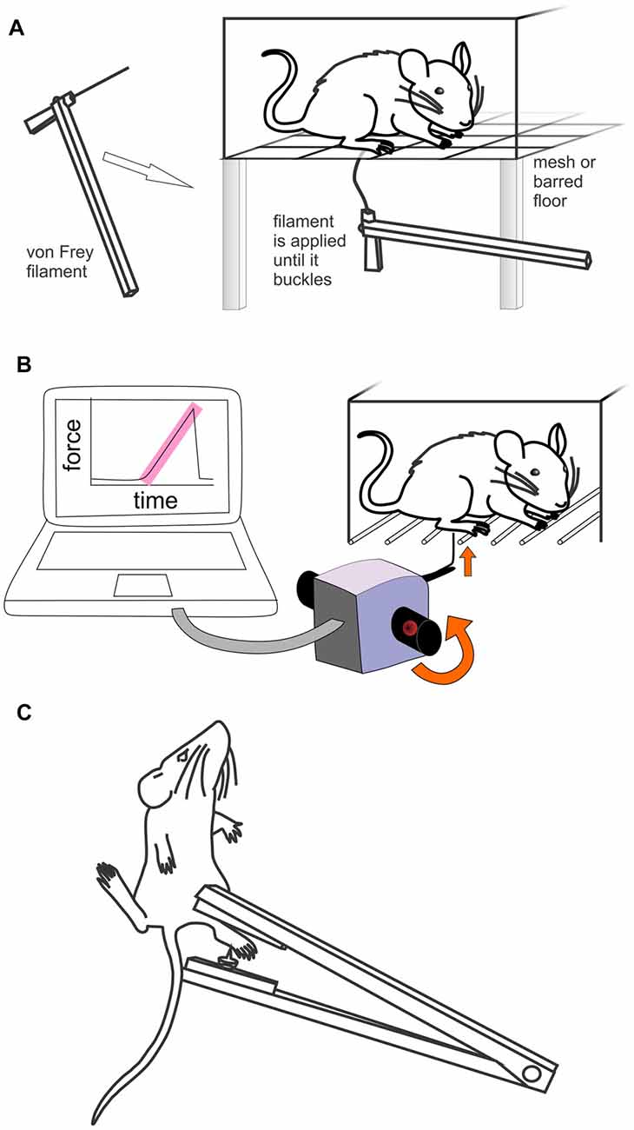
Methods
Nociceptive behavioral test
Notes:
Formulin was injected into the hind paw of the mouse and then measured to see what the mouse would display for pain response.

Slide 14
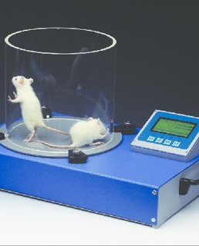
Methods
Hot Plate procedure
Notes:
- Measured how long it took for the mouse to pull away from the hot plat

Slide 15
Results

Slide 16
Notes:
The ability of a ligand to recruit different -arrestins to the MOR impacts regulation of the receptor

Slide 17
Notes:
Data shows the amount of mRNA in each area analyzed in this experiment. Per the paper- each area had low levels of mRNA.

Slide 18
Notes:
Shows how recruitment molecules play a role in Barrestin 1
Morphine did not have an affect on b-arrestin1 receptors despite DAMGO having a substance affect
GRK2 overexpression did not compensate for this loss of activation either.

Slide 19
Notes:
Showed how the recruitment molecules played a role in beta arrestin 2
Robust interactions seen
Induced B-arrestin MOR interactions
Morphine was less affective at inducing the B–arrestin MOR results than the DAMGO

Slide 20
Notes:
Question being asked in this experiment I the impact of Beta arrstin absence on agonist-induced MOR phosphorylation
Phosphoralying happened with or without the beta receptor. Thus no statistical difference could be made

Slide 21
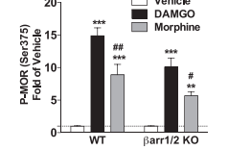
Notes:
Ser375 associated with phosphorylation events
Demonstrated that the agonostic affects are preserved whether b-arrestin is present or not

Slide 22
Notes:
- B-arrestin1 promotes the dephosphorylation of the MOR
If b-arrestin1 is absent the event is delayed
MOR is phosphorylated at a slower rate after morphine treatment and does not induce recruitment of B-arrestin1. this promotes b-arrestin 1 recruitment

Slide 23
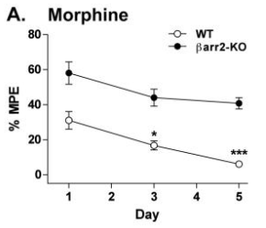
Notes:
Nociepetice response -
WT will display reduced antinociceptive response compared to the Barr2- KO mice who have little change in the antinociceptive responses

Slide 24
Notes:
Data concerning spinal doral horn neurons and nociceptive glutamatergic
MOR can stimulate a rebound potentiation with the initiation of opioid- induced hyperalgesia
DAMGO did not have any inhibitory affects
These findings prove that MOR in the presenaptic area with primary neurons is needed to stimulate the glutamatergic input.

Slide 25
Notes:
Schematic diagram shows the role of MORs expressed in primary sensory neurons in systemic opioid-induced analgesia and hyperalgesia MORs are highly expressed in primary sensory neurons and presynaptically at primary afferent terminals in the spinal superficial dorsal horn in WT mice. \. Furthermore, opioids can augment nociceptive transmission and induce hyperalgesia via stimulation of MORs expressed in a separate population (i.e. TRPV1-expressing) of primary sensory neurons and their central terminals in the spinal cord. \

Slide 26
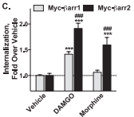
Notes:
MOR was not observed with either agonist in either B-arrestin with null MEFs

Slide 27
Notes:
Is the MOR ubiquination dependent on the presence of a specific b- arrestin
DAMGO promoted MOR ubiquitination via time-dependent manner
Morphine did not have an effect on WT and this is comparable to the Barr1/2 KO + DAMGO

Slide 28
Notes:
This gives us an understanding when comparing the vehicle to the knock outs. Beta arrestin 1 has more of an impact on mediation than beta arrestin 2. When it comes to recruitment of morphine linked molecules of activation.

Slide 29
Notes:
The test done here is the inflammatory test through the nociceptive behaviorural tests as mentioned above
Acute physological nociception is not controlled by endogenous opioid tone acting at MORs in primary senory neurons
Demonstrated through no difference between WT and Oprm-1-cKO mice
These graphs show that morphines anagesic affects peaked at 30 minutes. Then this would increase pain amongst the animals after the peak of morphine and peak increased temperature as seen in the bottom graph.
As you can also see mice that were cKOs had no effect and maintained. This proves that MOR receptors are important in the effects of opioid stimulation. With morphine

Slide 30
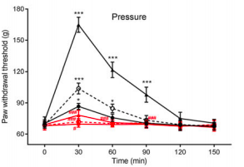
Notes:
The test done here is the inflammatory test through the nociceptive behaviorural tests as mentioned above
Acute physological nociception is not controlled by endogenous opioid tone acting at MORs in primary senory neurons
Demonstrated through no difference between WT and Oprm-1-cKO mice
These graphs show that morphines anagesic affects peaked at 30 minutes. Then this would increase pain amongst the animals after the peak of morphine and peak increased temperature as seen in the bottom graph.
As you can also see mice that were cKOs had no effect and maintained. This proves that MOR receptors are important in the effects of opioid stimulation. With morphine

Slide 31
Notes:
The test done here is the inflammatory test through the nociceptive behaviorural tests as mentioned above
Acute physological nociception is not controlled by endogenous opioid tone acting at MORs in primary senory neurons
Demonstrated through no difference between WT and Oprm-1-cKO mice
These graphs show that morphines anagesic affects peaked at 30 minutes. Then this would increase pain amongst the animals after the peak of morphine and peak increased temperature as seen in the bottom graph.
As you can also see mice that were cKOs had no effect and maintained. This proves that MOR receptors are important in the effects of opioid stimulation. With morphine

Slide 32
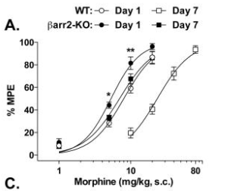
Notes:
Shows a right way shift compared to WT
With a slight shift with Barr2- KO indicating the MOR receptors play a roll in morphine utilization in the body even over a longer term endeavor

Slide 33
Notes:
Demonstrates that the number of MORs dictates how affective morphine is
Spinal cord injected- intrathecally injection

Slide 34
Notes:
Demonstrates that the number of MORs dictates how affective morphine is
Spinal cord injected- intrathecally injection

Slide 35
Notes:
Demonstrates that the number of MORs dictates how affective morphine is
Spinal cord injected- intrathecally injection

Slide 36
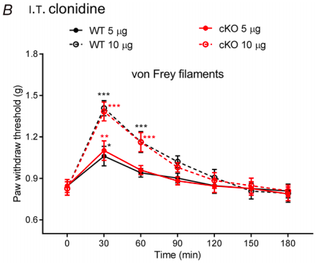
Notes:
CFA- is a painful test done to induce an inflammation response and this test was used to test how morphine would interact in pain responses in diseases that are inflammatory diseases.
These images give an insight about pain management utilizing opioids
This demonstrated the affects of MOR in primary sensory neurons with mediation of the opioid analgesic effects in inflammatory pain conditions
After three days reduced responses to pain in both groups was seen
Morphine reversed the results in WT
In the experimental group inject with Morphine caused the mice to still have no/minimal response to pain in a dose dependent manner. The Morphine did not reverse the effects since the mu receptor is knocked out of the mice as the only placeable answer based on this experiment

Slide 37
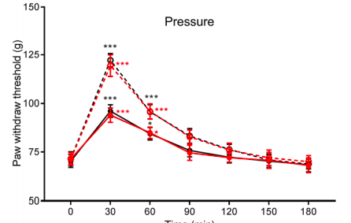
Notes:
CFA- is a painful test done to induce an inflammation response and this test was used to test how morphine would interact in pain responses in diseases that are inflammatory diseases.
These images give an insight about pain management utilizing opioids
This demonstrated the affects of MOR in primary sensory neurons with mediation of the opioid analgesic effects in inflammatory pain conditions
After three days reduced responses to pain in both groups was seen
Morphine reversed the results in WT
In the experimental group inject with Morphine caused the mice to still have no/minimal response to pain in a dose dependent manner. The Morphine did not reverse the effects since the mu receptor is knocked out of the mice as the only placeable answer based on this experiment

Slide 38
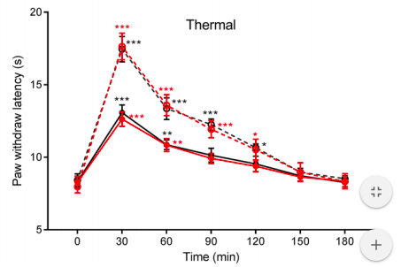
Notes:
CFA- is a painful test done to induce an inflammation response and this test was used to test how morphine would interact in pain responses in diseases that are inflammatory diseases.
These images give an insight about pain management utilizing opioids
This demonstrated the affects of MOR in primary sensory neurons with mediation of the opioid analgesic effects in inflammatory pain conditions
After three days reduced responses to pain in both groups was seen
Morphine reversed the results in WT
In the experimental group inject with Morphine caused the mice to still have no/minimal response to pain in a dose dependent manner. The Morphine did not reverse the effects since the mu receptor is knocked out of the mice as the only placeable answer based on this experiment

Slide 39
Notes:
daily intraperitoneal treatment with morphine (10 mg/kg, twice daily for 8 days)
Results complilation comparision of WT and OPRM-+cKO
- Affermates that no change occurs if individual do not have MOR

Slide 40
Notes:
daily intraperitoneal treatment with morphine (10 mg/kg, twice daily for 8 days)
Results complilation comparision of WT and OPRM-+cKO
- Ditto above

Slide 41
Notes:
daily intraperitoneal treatment with morphine (10 mg/kg, twice daily for 8 days)
Results complilation comparision of WT and OPRM-+cKO
- Ditto above

Slide 42
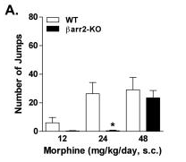
Notes:
Morphine had the significant different amongst all the drugs. I only included this one because of it’s potential discussion and to continue with the theme of focusing on Morphine.
This shows a global score- this is calculated based on weight and number of times a withdrawal symptom is demonstrated. This chart was created after causing a physical dependency to morphine.
- WT tmice had a higher global score compared to the Barr2-KO mice until the morphine dose was higher.

Slide 43
Conclusion
Notes:
MORs in primary sensory neurons play an essential role in the inhibitory effects of systemically administered opioids on both nociception and persistent inflammatory pain as demonstrated throughout the articles.
With that in mind reducing MORs receptors through genetic ablation results in reduced opioid affect. Since the reduced amount of mu receptors is present. This could be a target of therapeutic affects. By targeting mu receptors numbers, with reduced numbers this could be a potential mechanism that is also less painful and could cause less relapse. Exploration of realistically reducing the receptors would have to be explore either through inhibition methods similar to enzyme effects or ablating the receptors completely.
A potential molecule of interest for B-arrestin 2 is GRK regulation. Along with G coupled receptors for regulation of activation too.
Final therapeutic opportunity is dependent on the associated molecules; could recruit beta arrestin 1 instead of beta arrestin 2 activating MOR. Further research should be conducted on what molecule would be the best associated molecule of target. Particularly if one target molecule has affects in other ares of the body would inhibiting that molecule cause more harm than good. Another aspect is if the target molecule of inhibition associated with the MOR receptor would also cause a decrease in other areas of the brain that light up with addiction. While this was a presentation about pain, which chronic pain comes the ability to become addicted to the very medicine that helps someone, and this could also lead to other addictions.
Optional-
With the theory of decreased receptors through ablation as seen in the mice group that was KO-MOR, higher doses of morphine was needed in the experiments that were focused on to induce an effect. While this is true for Morphine. However, there may be another options rather than ablating a useful receptor when it comes to pain management. While beta arrestin does not sitmulate pain it was shown to be important in the MOR receptor mediation of pain when administered opioid. Without the beta receptors both 1 and 2 it significantly had an impact on the pain management needed for the mice during tests.
The MOR receptor is impacted by beta-arrestin levels throughout the brain. Without beta arresting the MOR receptors are less affected via G-protein receptor .
The beta- arrestin affects should be closely looked at as a mediation of additions. The MOR receptor need beta arrestion to activate the g protein receptors and have the analgesic affects of morphine to become apparent based on tests.
administered opioids. Principally mediated by MORs expressed at the first sensory synapse in the spinal cord, where they are crucially involved in regulating nociceptive input from primary sensory nerves.
While they were genetically engineered to not have the mu receptor or reduced mu receptors doing this in humans maybe controversial. Especially, if only select groups are chosen to do it such as those who have addition throughout their family and particularly drug or alcohol addition if other receptors were found to be correlated with the MOR receptors.
The effects of opioid particularly with morphine:
Less server analgesia effects were demonstrated in the MOR recepter B- arrestin interaction
B arrestin recruitment is subjective to recruiter molecules just like other effects within the body.
The prominate beta- arrestin receptor for morphine is beta arrestin2 rather than beta arrestin 1.
Through the experiments observations were made that:
Betaarrestin2 is highly involved with morphine in regards to induced tolerance in the hot plate test
Barr2-KO mice had an enhanced hypothermic response to morphine

Slide 44
Discussion and Questions
Future experiments to investigate MOR receptors more?
Knowing more?
Addition impact
Notes:
What do we need to know more in relation to the MOR receptors and the body? What other pathways of consideration should be made when determining if the MOR receptor is the receptor we should be targeting with b-arrestin?
Could knowing more about the MOR receptors impact how we handle individuals addicted to opioids.
Could this help with the opioid crisis that we are in right now? Would it only cause more people to try drugs knowing the pathway and that a treatment is out there to help them when they become addicted to it?
Do you thinking knowing how many receptors are present in someone could determine their likelihood of becoming addicted to certain opioids? Do you think this is a way of determining how many time someone could have before they became addicted to various opioids?

Slide 45
Reference
Groer CE, Schmid CL, Jaeger AM, Bohn LM. Agonist-directed interactions with specific beta-arrestins determine mu-opioid receptor trafficking, ubiquitination, and dephosphorylation. J Biol Chem. 2011 Sep 9;286(36):31731-41. doi: 10.1074/jbc.M111.248310. Epub 2011 Jul 14. PMID: 21757712; PMCID: PMC3173119.
Raehal KM, Bohn LM. The role of beta-arrestin2 in the severity of antinociceptive tolerance and physical dependence induced by different opioid pain therapeutics. Neuropharmacology. 2011 Jan;60(1):58-65. doi: 10.1016/j.neuropharm.2010.08.003. Epub 2010 Aug 14. PMID: 20713067; PMCID: PMC2981657.
Sun J, Chen SR, Chen H, Pan HL. μ-Opioid receptors in primary sensory neurons are essential for opioid analgesic effect on acute and inflammatory pain and opioid-induced hyperalgesia. J Physiol. 2019 Mar;597(6):1661-1675. doi: 10.1113/JP277428. Epub 2019 Jan 16. PMID: 30578671; PMCID: PMC6418757.

